Slide 1
Interference from Non-Target Items in Change-Detection Task
Hsuan-Yu Lin/Klaus Oberauer

Slide 2
Working Memory Capacity
Working memory capacity as hard limit:
Slot model
Resource model
Interference explanation without hard limit:
The limitation comes from the interference between items.
The more items in the memory -> more interference.
Interference Model (Oberauer & Lin, 2017)

Slide 3
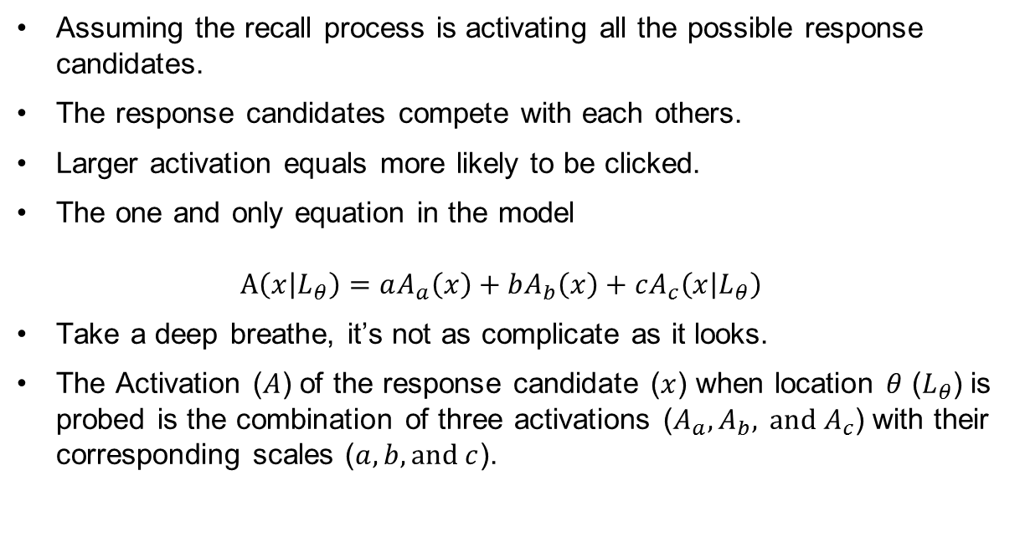
Interference Model
Assuming the recall process is activating all the possible response candidates.
The response candidates compete with each others.
Larger activation equals more likely to be clicked.
The one and only equation in the model $A\left(x | L_{θ}\right)=aA_{a}\left(x\right)+bA_{b}\left(x\right)+cA_{c}\left(x | L_{θ}\right)$
Take a deep breathe, it’s not as complicate as it looks.
The Activation ($A$) of the response candidate ($x$) when location $θ$ ($L_{θ}$) is probed is the combination of three activations ($A_{a}, A_{b}, \text{and}{ A}_{c}$) with their corresponding scales ($a, b,\text{and} c$).

Slide 4

Interference model
$$A\left(x | L_{θ}\right)=aA_{a}\left(x\right)+bA_{b}\left(x\right)+cA_{c}\left(x | L_{θ}\right)$$
Activation from context-independent source.
Activated by recently experienced items regardless the location of probe and the location of items.

Slide 5

Interference model
$$A\left(x | L_{θ}\right)=aA_{a}\left(x\right)+bA_{b}\left(x\right)+cA_{c}\left(x | L_{θ}\right)$$
Background-noise activation.
By product of the encoding process.

Slide 6

Interference model
$$A\left(x | L_{θ}\right)=aA_{a}\left(x\right)+bA_{b}\left(x\right)+cA_{c}\left(x | L_{θ}\right)$$
Cued-retrieval activation.
Activated by reactive the location-color binding formed during the encoding process.

Slide 7

Interference model
$$A\left(x | L_{θ}\right)=aA_{a}\left(x\right)+bA_{b}\left(x\right)+cA_{c}\left(x | L_{θ}\right)$$
Activation from cued retrieval.
Activated by reactive the location-color binding formed during the encoding process.

Slide 8
Interference model
And that’s the model!
Interference comes from:
Cued retrieval.
Competition between response candidates.
Previously, we implemented IM to continuous reproduction task.

Slide 9
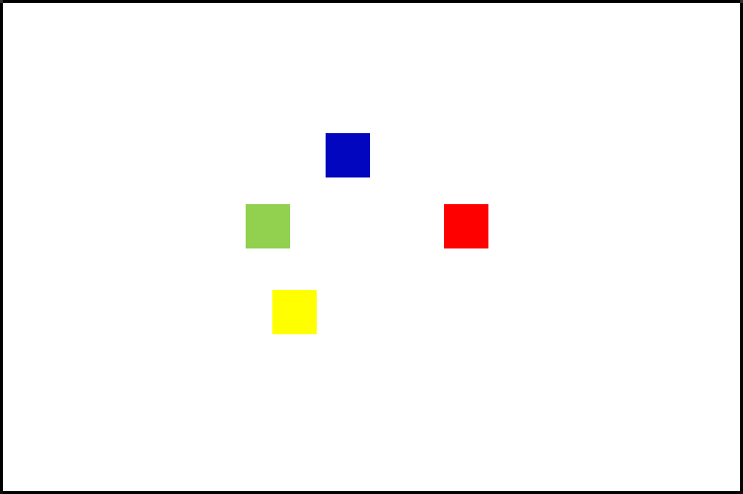
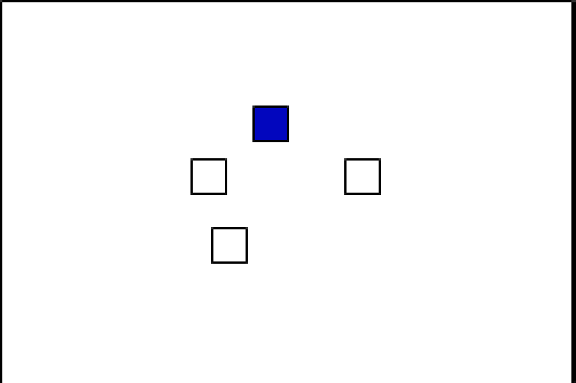
Change-Detection Task

Slide 10
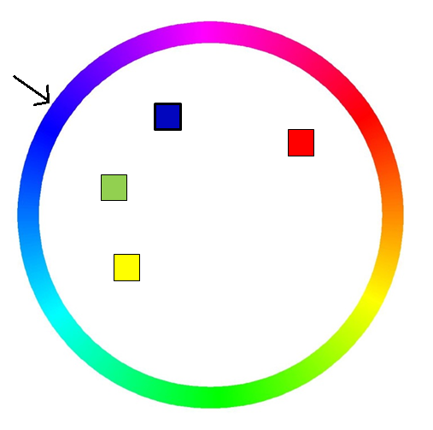
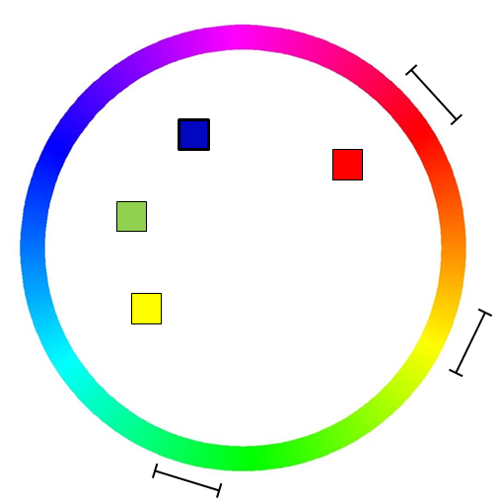
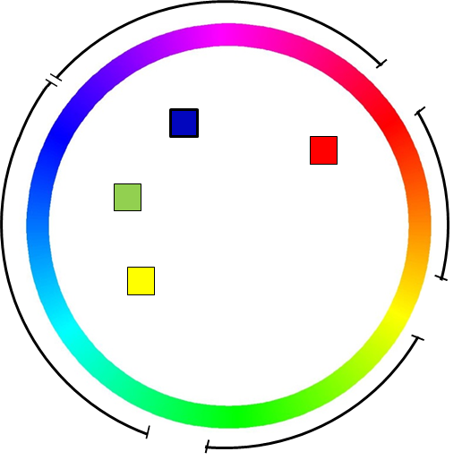
Interference from Non-target Items
Re-categorized the probes:
Positive
Intrusion
New

Slide 11
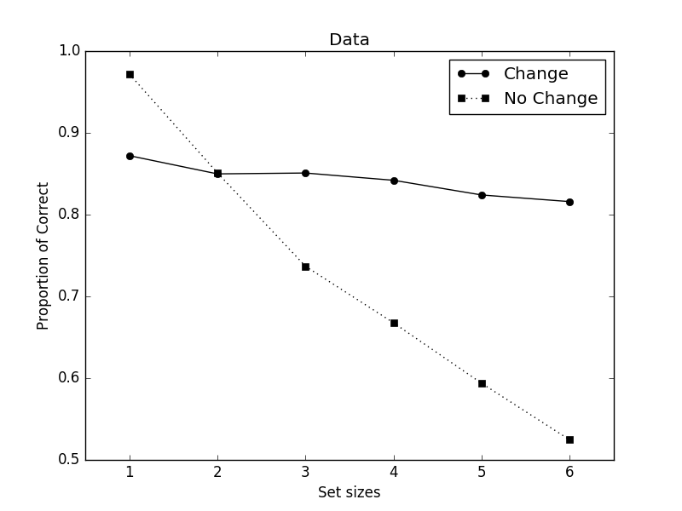
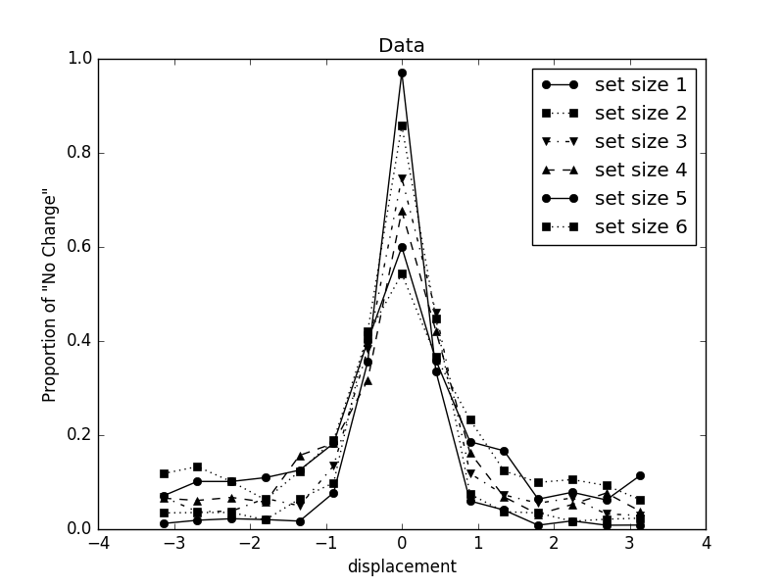
Results
Set-size effect
Response distribution

Slide 12
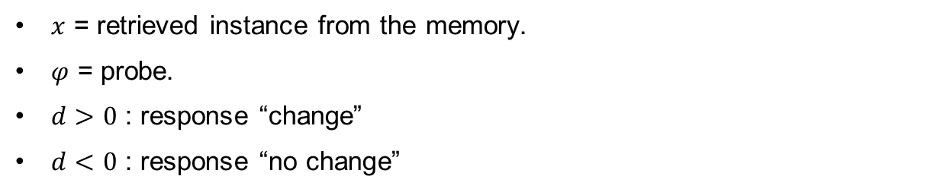
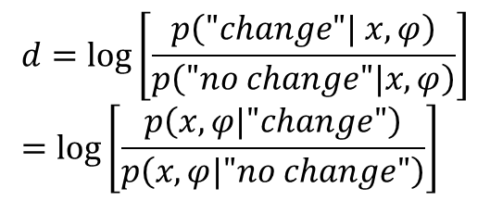
Bayes Inference (Keshvari, van den Berg, & Ma, 2013)
$$d=\log\left[\frac{p\left("change"| x, φ\right)}{p\left("no change"|x, φ\right)}\right] \\ =\log\left[\frac{p\left(x, φ|"change"\right)}{p\left(x, φ|"no change"\right)}\right]$$
$x$ = retrieved instance from the memory.
$φ$ = probe.
$d>0$ : response “change”
$d<0$ : response “no change”
Notes:
In layman’s term, given the probe and the retrieved instance, is the probe more likely to come from the “change’” condition or the no-change condition.

Slide 13
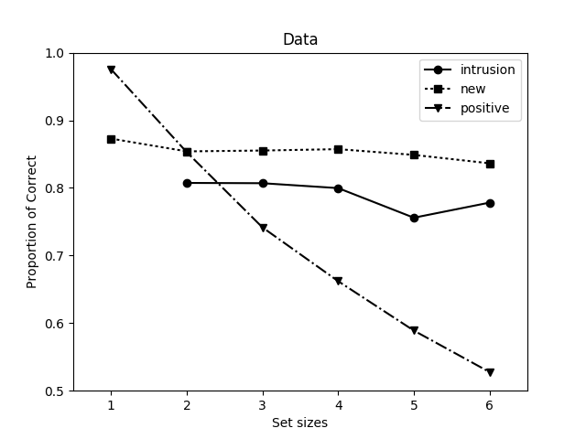
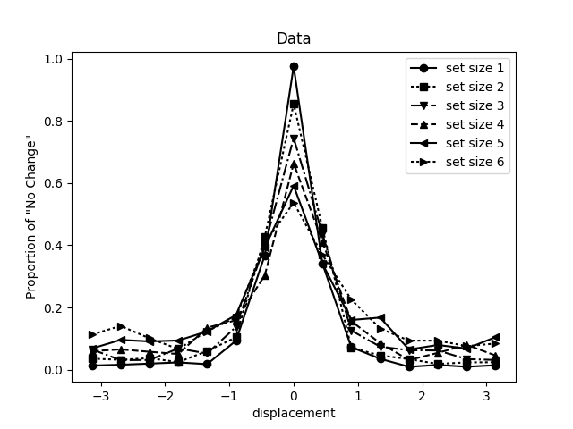
Data
Probe Type
Response Distribution

Slide 14
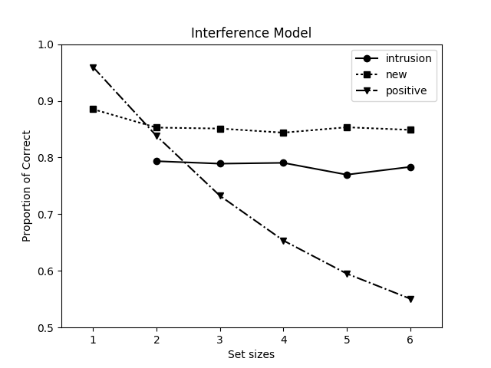
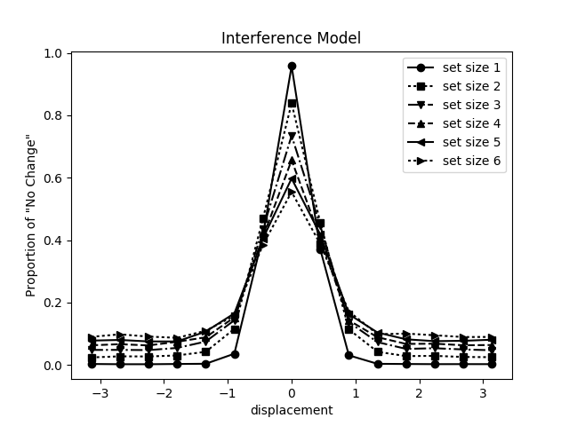
Interference Model
Probe Type
Response Distribution

Slide 15
Model Name: Interference Model, AIC: 39374.48509416144
Parameters: ['b', 'a', 's', 'kappa', 'kappa_f', r']
Parameters median: [ 0.0138 0.139 2.79 17.48 43.39 0.0705]
Parameters mean: [ 0.0330 0.207 5.37 20.07 48.47 0.0706]

Slide 16
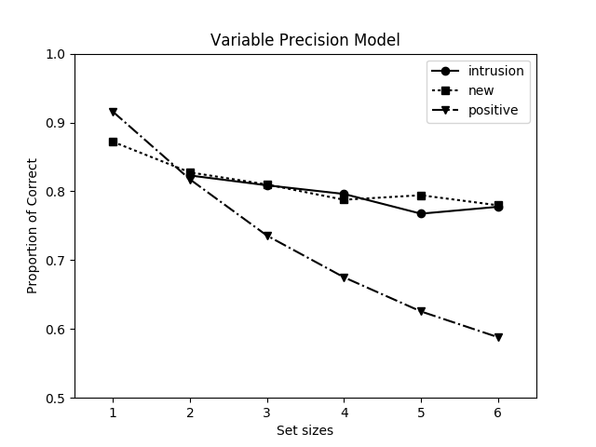
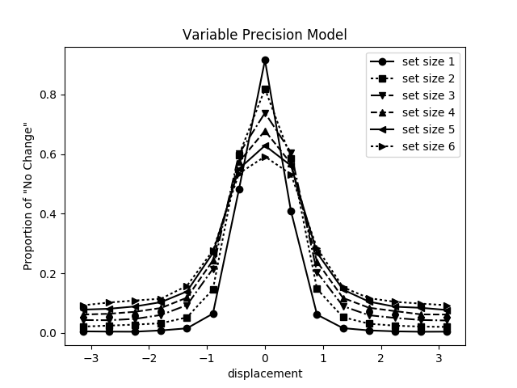
Variable Precision
Probe Type
Response Distribution

Slide 17
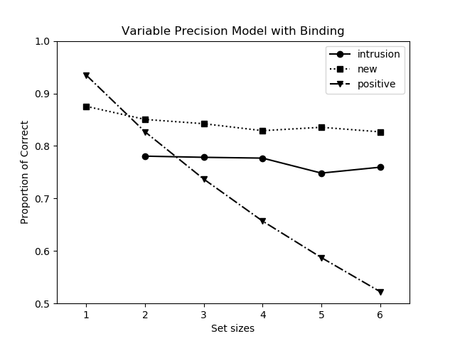
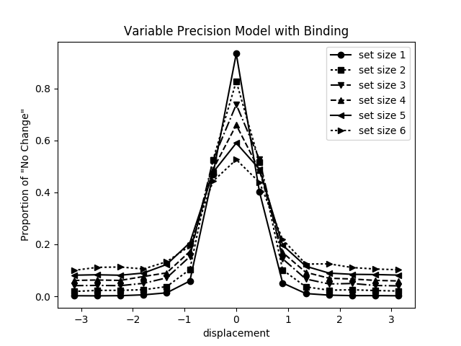
Variable Precision Biding
Probe Type
Response Distribution

Slide 18
Model Name: Variable Precision Model, AIC: 40964.289815251075
Parameters: ['J1', 'tau', 'aplha']
Parameters median: [ 86.53 84.16 0.967]
Parameters mean: [ 76.66 71.75 0.942]
Model Name: Variable Precision Model with Binding, AIC: 39958.2773497592
Parameters: ['J1', 'tau', 'aplha', 's']
Parameters median: [ 78.02 47.13 0.627 0.0868]
Parameters mean: [ 71.73 54.35 0.585 0.0907]

Slide 19
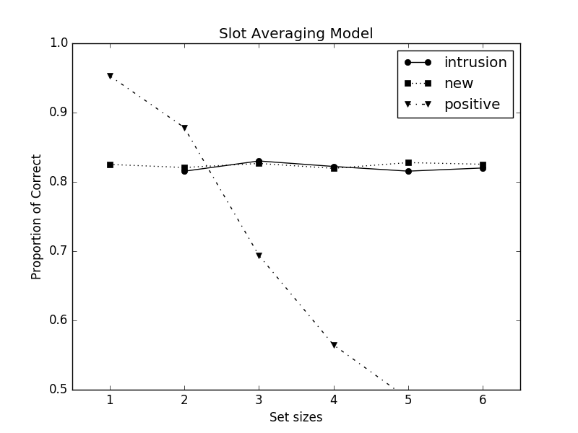
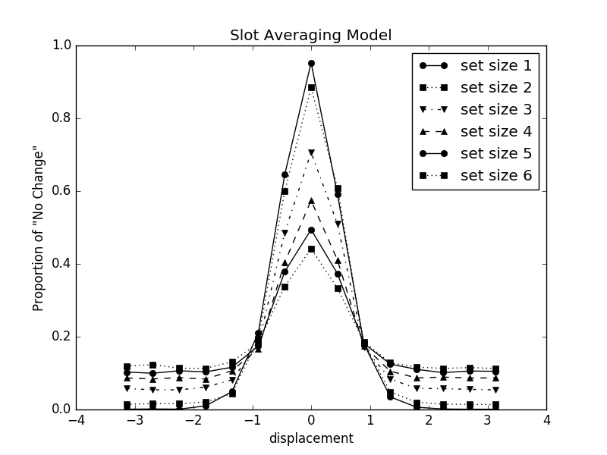
Slot-averaging model (no PM in inference)
Probe Type
Response Distribution

Slide 20
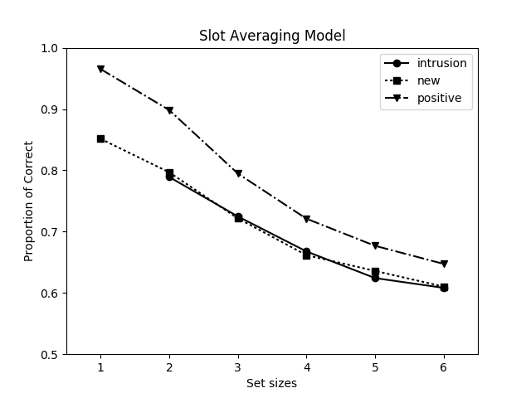
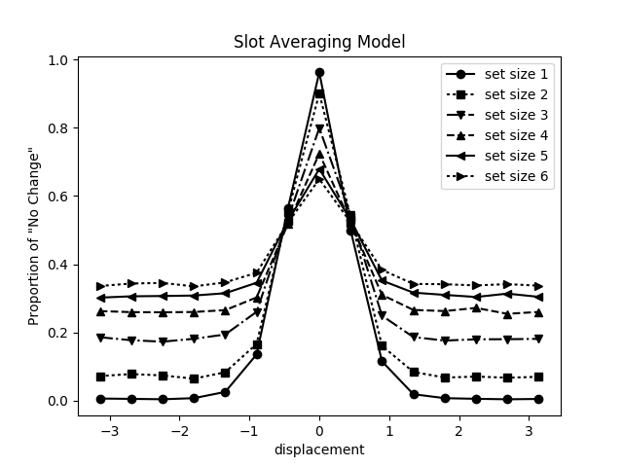
Slot-averaging model
Probe Type
Response Distribution

Slide 21
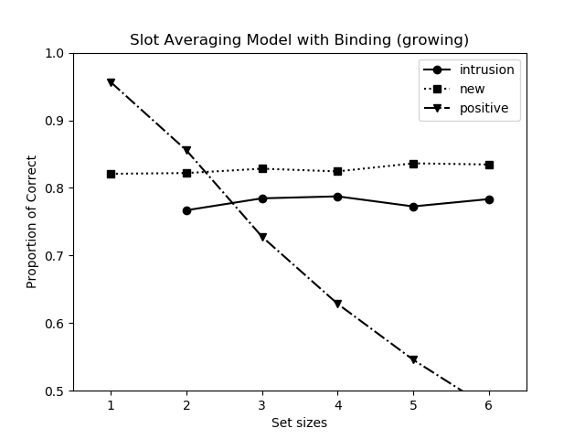
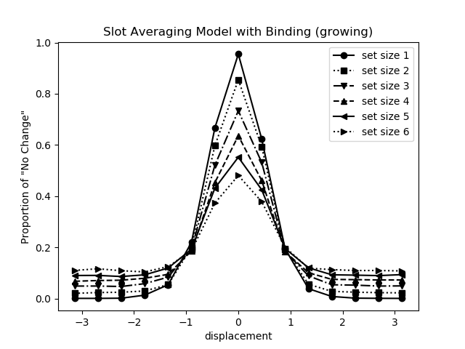
Slot-averaging + Swap model
Probe Type
Response Distribution

Slide 22
Model Name: Slot Averaging Model, AIC: 44974.97870198049
Parameters: ['k', 'kappa']
Parameters median: [ 1.79 30.34]
Parameters mean: [ 1.88 32.40]
Model Name: Slot Averaging Model with Binding (growing), AIC: 40763.879413394054
Parameters: ['k', 'kappa', 's']
Parameters median: [3.72002177 16.17506233 0.07360088]
Parameters mean: [4.06078811 17.89454396 0.06385492]

Slide 23
Conclusion
Interference Model is the only model able to predict the intrusion cost without additional assumptions.
Maybe we don’t need a hard limit to explain working memory capacity.

Slide 24
Caveat
The set-size effect of the intrusion cost
IM can not predict any the effect of set size on intrusion cost
However, there might be a set size effect.
Bayes factor is 0.39 in favor of no set-size effect in the presented experiment.

Slide 25
Thank you for you attention. Please don’t ask mean questions.

